Slide 1
Entrepreneurship Motivation

Slide 2
Motivation
Motivation is derived from the word motive which is defined as a need that requires satisfaction.
Motivation is the inner feeling or force that encourages a person to act or achieve a goal.
Key Elements:-
Intensity- how hard a person tries.
Direction- towards benefits or goal.
Persistence-how long a person tries.

Slide 3
TYPES OF MOTIVATION
Intrinsic Motivation- Intrinsic motivation is a type of motivation in which an individual is being motivated by internal desires.
Eg- Desire to achieve something big, love for innovation, want to prove capability and etc.
2. Extrinsic Motivation- Extrinsic motivation, on the other hand, is a type of motivation in which an individual is being motivated by external desires.
Eg- Earning money, government support, family pressure, unemployment and etc.

Slide 4
Entrepreneurial motivation
The entrepreneurial motivation is the process that activates and motivates the entrepreneur to exert higher level of efforts for the achievement of his/her entrepreneurial goals.

Slide 5
General Entrepreneurial motivation factors
Need for achievement
Locus of control (believe that my success depends on me, always ready to improve)
Vision
Desire for independence
Passion
Drive(a very strong need or desire in human beings that is a strong push)

Slide 6
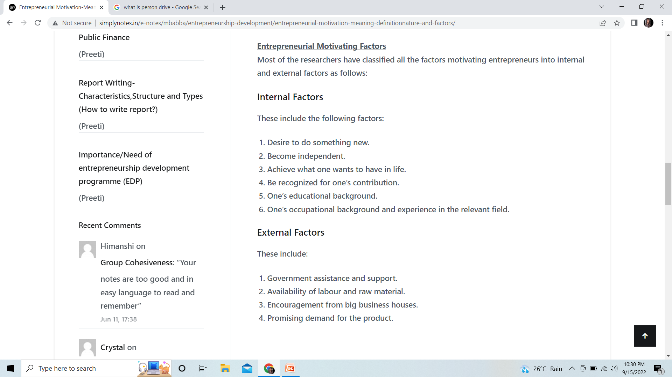

Slide 7
David McClelland’s theory of Achievement motivation
Motivation is an important determinant for entrepreneurial growth.
Three motives for accomplishing things:
Need for Power (nP), or the drive to influence others and any given situation.
Need for Affiliation (nAff), or the drive for interpersonal relationship.
Need for Achievement (nAch), or the drive to excel, advance, and grow.
*ALREADY COVERED IN Psychological MODEL*

